Slide 1
CLASS RELATION
Object-ORIENTED programming – meeting 4

Slide 2
Types of relationships
There are 4 basic types of relationships between classes: Inheritance Association Aggregation Composition

Slide 3
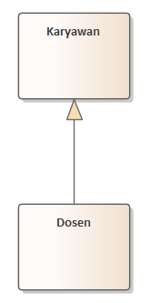
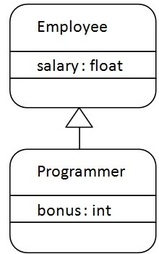
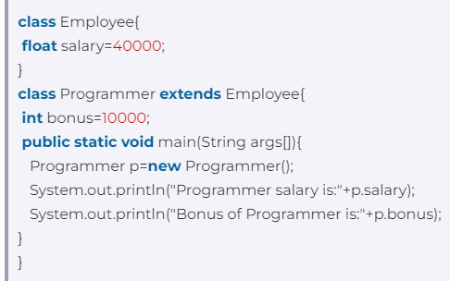
Inheritance
Describe the relationship between a more general class (parent/superclass) and a more specialized class (child/subclass) "is-a" relationship Example: The lecturer is an Employee A cat is an animal A room is a building A car is a vehicle
Employee
Lecturers

Slide 4
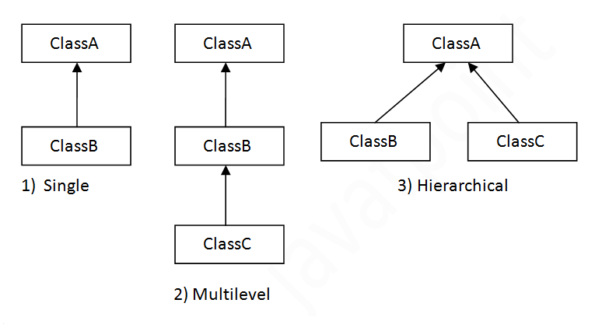
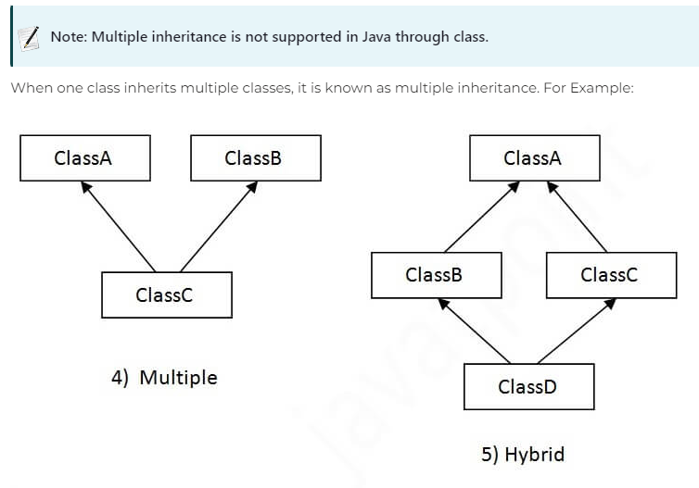
Types of inheritance
https://www.javatpoint.com/inheritance-in-java

Slide 5
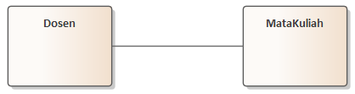
association
Associations are relationships between interrelated objects in a system "has-a" relationship Example: Lecturers and Courses Students and Courses
Lecturers
Courses

Slide 6
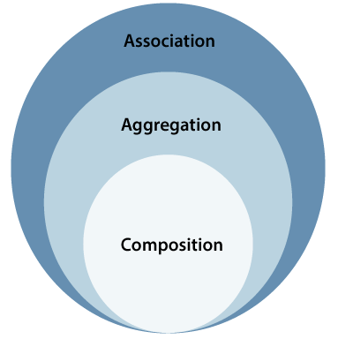
ASSOCIATION

Slide 7
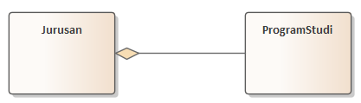
aggregation
Aggregation is a special form of Association where there is ownership between one class and another, but each object has its own life-cycle Unidirectional association/one-way relationship "has-a" + "whole-part" relationship Ownership means that there is ownership between the two classes. Example: The department consists of several Study Programs Study Programs are part of the Department of Departments and Study Programs have their own life-cycles, meaning that if a Department is deleted, the Study Program is not automatically deleted as well.
Department
Study Program

Slide 8
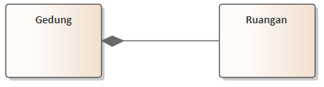
composition
Composition is a special form of Aggregation where there is ownership between classes but the child object does not have its own life-cycle without the parent object Not having its own life cycle means that a child object cannot be created without a parent object; The child object will also be deleted if the parent object is deleted. Example: The building consists of rooms Employees have dependents E-mails have Attachments
Building
Rooms

Slide 9
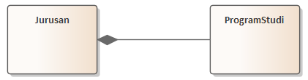
DEPARTMENTS & COURSES
If the department is deleted, the study program will automatically be deleted
If the department is deleted, the study program can move to another aggregation department
Department
Study Program
Department
Study Program

Slide 10
MULTIPLICITY NOTATION
Example | Information
1 | Exactly one
0..1 | Zero or one
0..* | Zero or more
1..* | One or more
3..5 | 3 to 5

Slide 11
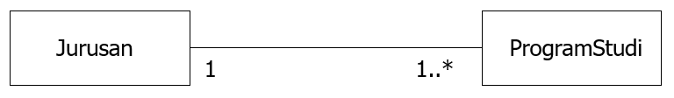
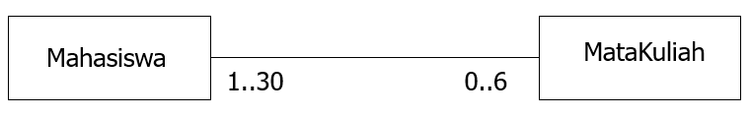
MULTIPLICITY NOTATION
Department
Study Programs
Students
Subject

Slide 12
Multiplicity Assertion/Constraint
enroll
Student
Course
5..*
3..5
A student must enroll in three to five course and
a course must have at least five students.
Other multiplicity constraints:
1 exactly one 1..* one or more
0..1 zero or one 3..5 three to five
0..* zero or more 4 exactly four

Slide 13
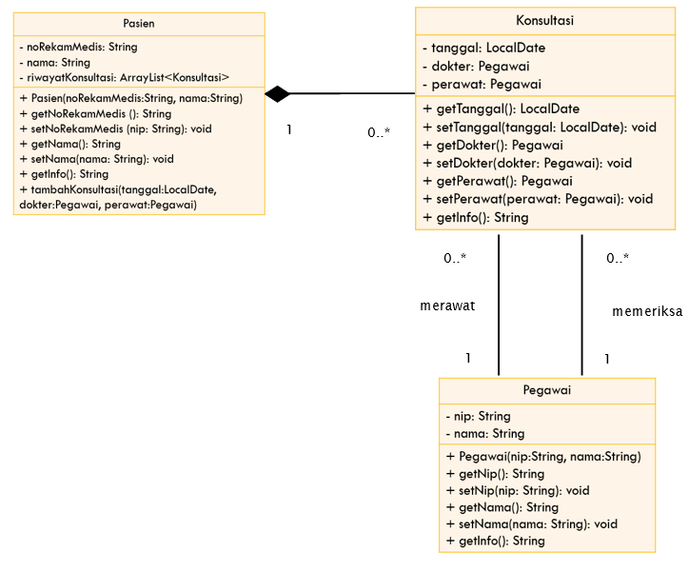

Slide 14
tASK
Create a case study with a minimum of 3 classes that are associated with each other. Create at least 1 attribute of type ArrayList of objects Define the attributes and methods on each class Draw the diagram class.

